Slide 1
POWER BI
By-
RISHABH SAHNI
2021A7PS1630P

Slide 2
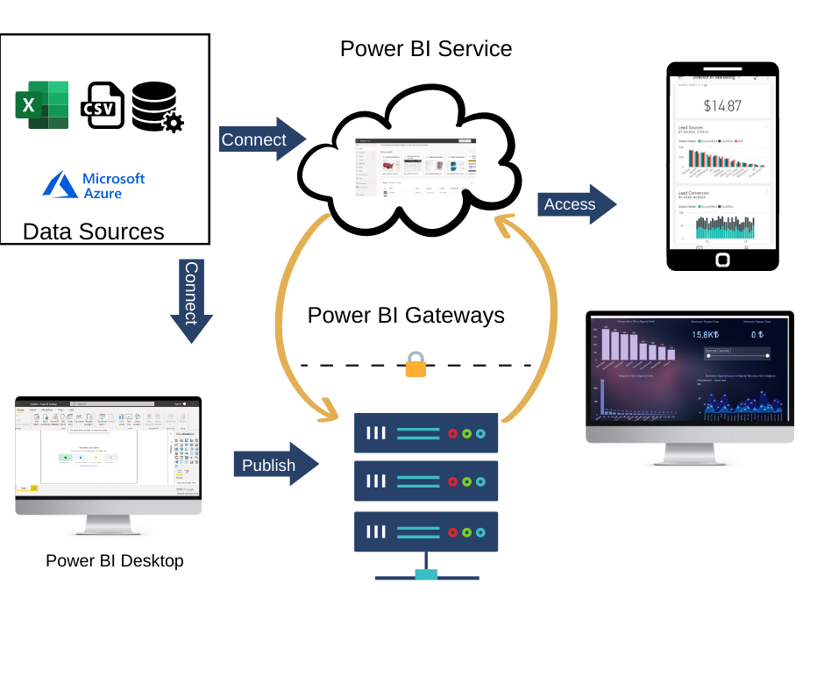
What is power bi ?
Power BI is a Data Visualization and Business Intelligence tool that converts data from different data sources to interactive dashboards and BI reports.
Power BI suite provides multiple software, connector, and services – Power BI desktop, Power BI service based on SaaS, and mobile power BI apps available for different platforms. These set of services are used by business users to consume data and build BI reports.
Power BI desktop app is used to create reports, while Power BI service is used to publish the reports, and Power BI mobile app is used to view reports and dashboards.

Slide 3
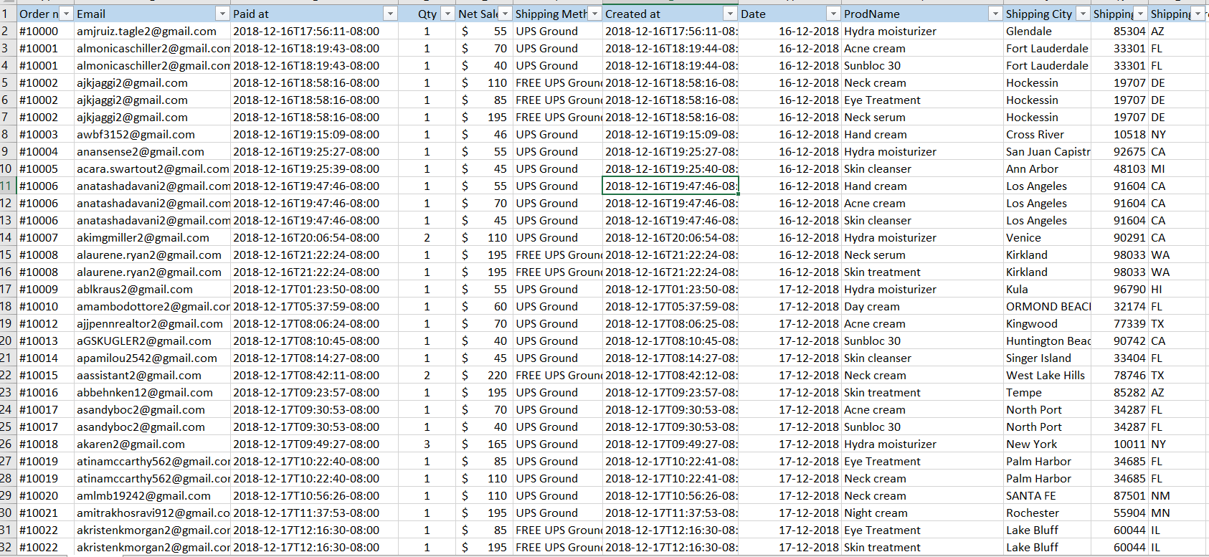
Data Overview
The provided dataset contains information about customer orders, including various details such as order numbers, customer email addresses, payment timestamps, quantities, net sales amounts, shipping methods, order creation timestamps, dates, product names, shipping cities, postal/zip codes, and shipping provinces. These data points enable analysis of key aspects such as revenue trends, customer behavior, top-selling products, and shipping patterns.

Slide 4
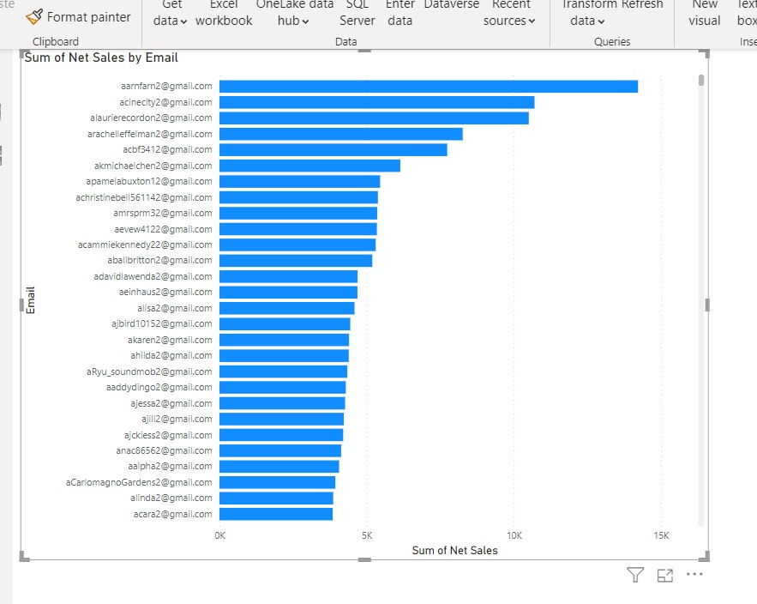
Top Customers by Revenue
STEPS
Launch Power BI Desktop and import the relevant data.
Drag and drop the "Customer_Email" and “Net Sales" fields onto the report canvas.
Choose a suitable visual type such as a bar chart.
Sort the visual in descending order based on revenue to highlight the top customers.
Customize the visual by adding titles, adjusting colors, and formatting as desired.

Slide 5
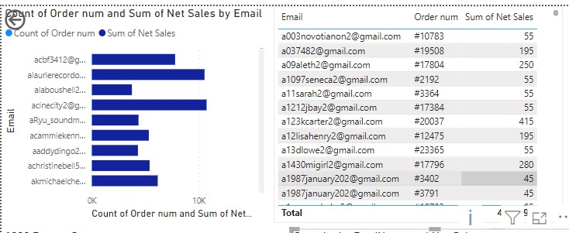
Top Customers by Number of Orders
STEPS
Launch Power BI Desktop.
Import the relevant data containing information about customer orders.
Drag and drop the "Customer_Email" field and the “Qty of Orders" field onto the report canvas.
Choose a suitable visual type to represent the data, such as a bar chart or a table.
Sort the visual in descending order based on the number of orders to highlight the top customers.
Customize the visual by adding titles, adjusting colors, and formatting as desired.

Slide 6
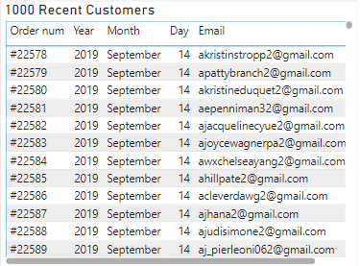
1000 Most Recent Customers
STEPS
Launch Power BI Desktop.
Import the relevant data containing customer information.
Drag and drop the desired fields (e.g., "Customer Email" and "Created at") onto the report canvas.
Choose a suitable visual type such as a table or a matrix to display the customer information.
Sort the visual in descending order based on the "Created at" field to show the most recent customers at the top.
Limit the table or matrix to display only the top 1000 rows or customers.
Customize the visual by adding titles, adjusting colors, and formatting as desired.

Slide 7
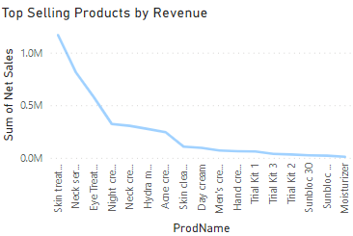
Top Selling Products by Revenue
STEPS
Drag and drop the "ProdName" field and the "Net Sales" field onto the report canvas.
Choose a suitable visual type to represent the data, such as a bar chart or a table.
Set the "ProdName" field as the category or axis of the visual.
Set the "Net Sales" field as the values or measures of the visual.
Sort the visual in descending order based on the revenue to highlight the top selling products.
Customize the visual by adding titles, adjusting colors, and formatting as desired.

Slide 8
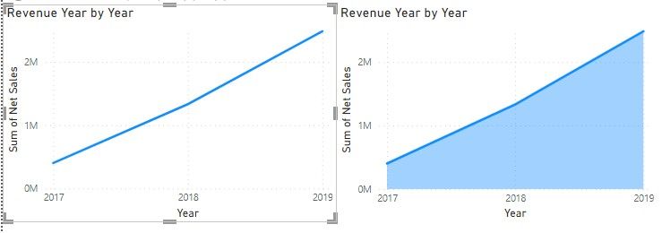
Trend in Revenues from Products Year after Year
STEPS
Import the relevant data containing product sales information, including the "Created at" or "Date" field and the "Net Sales" field.
Drag and drop the "Created at" or "Date" field to the axis or category section of the visualizations pane.
Drag and drop the "Net Sales" field to the values section of the visualizations pane.
Choose a suitable visual type to represent the trend, such as a line chart or area chart.
Customize the visual by adding titles, adjusting colors, and formatting as desired.

Slide 9
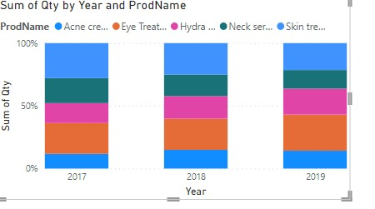
Top 5 Products with the Highest Repeat Rate for Each Year
STEPS
Drag and drop the "Created at" or "Date" field to the axis or category section of the visualizations pane.
Drag and drop the "ProdName" field to the legend section of the visualizations pane.
Drag and drop the "Qty" field to the values section of the visualizations pane.
Choose a suitable visual type to represent the data, such as a stacked column chart or stacked bar chart.
Sort the visual within each year in descending order based on the repeat rate (quantity) to highlight the top 5 products.
Customize the visual by adding titles, adjusting colors, and formatting as desired.

Slide 10
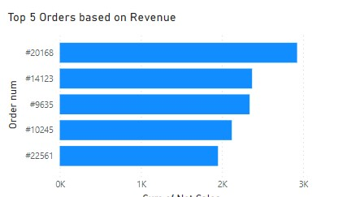
Top Orders by Revenue
STEPS
Drag and drop the "Order num" field to the values section of the visualizations pane.
Drag and drop the "Net Sales" field to the values section of the visualizations pane as well.
Choose a suitable visual type to represent the data, such as a bar chart or a table.
Sort the visual in descending order based on the revenue to highlight the top orders.
Customize the visual by adding titles, adjusting colors, and formatting as desired.

Slide 11
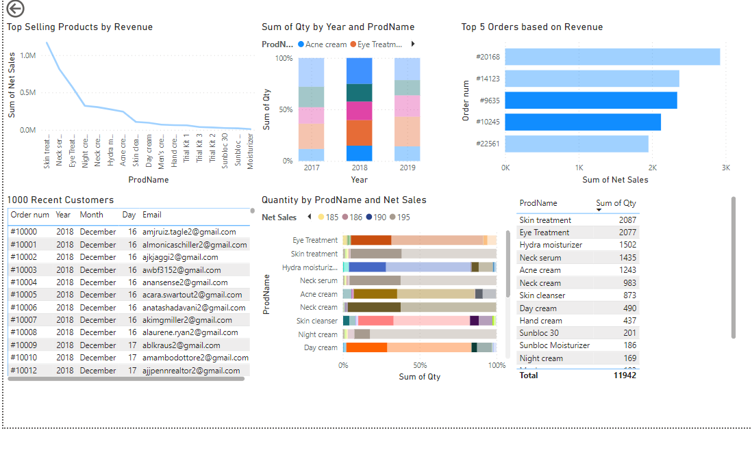
CONCLUSION
In conclusion, the presentation focused on utilizing Power BI to analyze customer data and product sales. Through various visualizations, we gained valuable insights that can drive strategic decision-making and enhance business performance. The key findings include identifying top customers by revenue, number of orders, and average order value, as well as analyzing the 1000 most recent customers. We also examined the top-selling products in terms of revenue and volume, tracked the trend in product revenues year after year, and identified the top 5 products with the highest repeat rate for each year. Additionally, we highlighted the top orders by revenue. By harnessing the power of Power BI, we were able to gain a deeper understanding of our data, enabling us to make informed decisions, improve customer segmentation, and drive business growth.

Slide 12
Thank You

